Slide 1
NaTour4CChange
Izidora Marković Vukadin
Institute for tourism
Rome, 10th April 2024

Slide 2
NaTour4CChange objective and theory of change
issue: tourism destinations with natural assets of high value and suffering major tourism-related impacts on/from Climate Change
solution: improving the regional tourism governing capacities + supporting/strengthening DMOs to test innovative solutions (i.e. Nature-based Solutions)
change: Regional administrations that become more effective in planning sustainable tourism in order to mitigate CC contributions and improve CC adaptation; pilot tourism destinations that become more resilient against CC impacts
To improve sustainability and increase the resilience of coastal Mediterranean tourism destinations towards climate change, improving the engaged regional territories’ capacities of governing tourism development at local level through ecosystem-based approaches and capitalising the twofold role of nature: as tourism attractive and as a solution for destination resilience

Slide 3
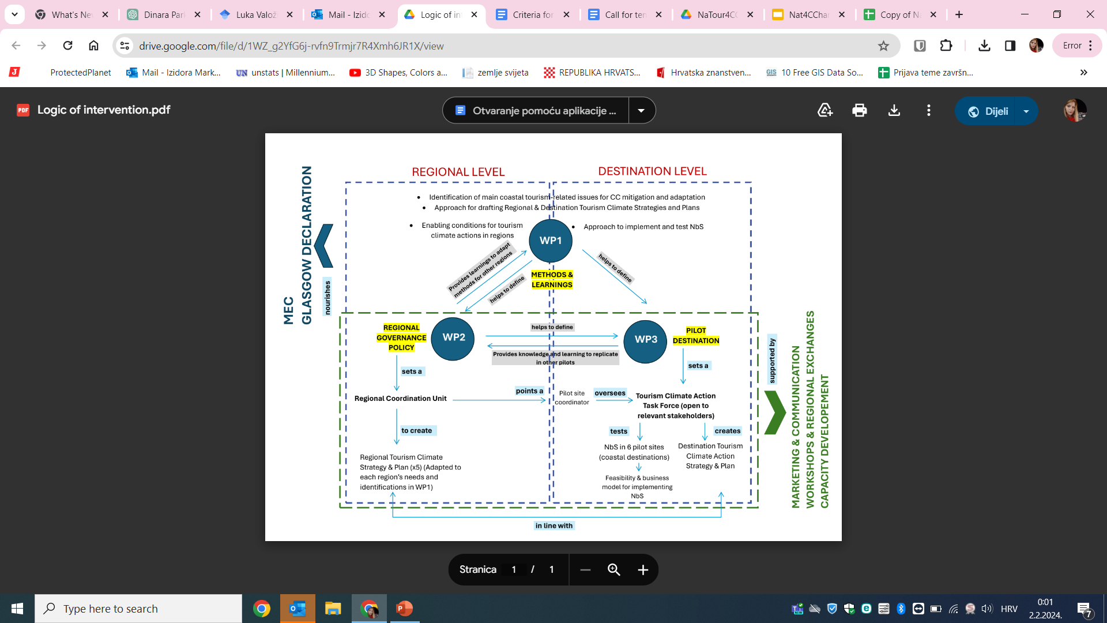
Nature4CChange main activities
Notes:
NaTour4CChange builds on and capitalises on successful experiences at the Mediterranean and global level to test solutions for increasing the resilience of coastal destinations in the Mediterranean. The project will aim to set common methods to allow participating regions to assess their tourism-related climate adaptation and mitigation priorities, and take climate action via plans and strategies, supported by cooperative governance.
In coastal destinations, cross-sector teams will deliver specific tourism climate Action Plans, focusing on climate adaptation, where Nature-based Solutions (NbS) will be tested to ensure their feasibility. At the same time, innovative destination marketing and communication approaches will engage private stakeholders, visitors, and residents in climate action.
The project will also ensure cross-fertilisation among participating regions and destinations, to achieve common methods and to compare the different tested plans and solutions, leading to lessons, best practices, and policy.

Slide 4










NaTour4CChange pilot areas
Andalucía Region – Spain
Sardinia Region – Italy
Zadar County – Croatia
Crete Region – Greece
Herzegovina-Neretva Canton – B&H
Region in South France
Institute for Tourism – Croatia (LP)
Plan Bleu – France (WP1 Coord.)
CPMR – France (WP2 Coord.)
IUCN Med – Spain (WP3 Coord.)
HSPN – Greece (Comm.coord.)
Local pilot sites with high natural value and developed tourism infrastructure

Slide 5
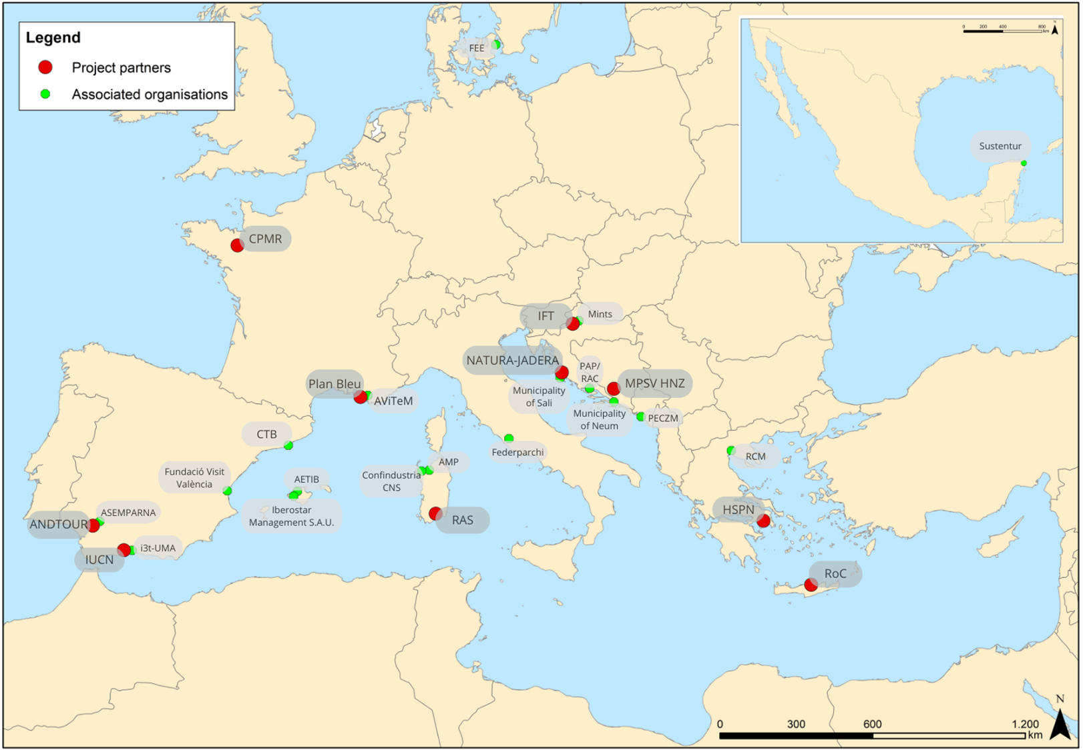
NaTour4CChange pilot areas

Slide 6
NaTour4CChange main outputs
5 Regional Strategies on Climate mitigation and adaptation for the coastal tourism sector, including Enabling conditions for delivery
6 Destination Climate Action Plans for adaptation of the coastal tourism sector
1 Capitalization Report that describes the whole approach for planning CC resilience in the tourism sector, including lessons learnt and policy recommendations
6 Reports on designed/strengthened /assessed NbS
10 Project Partners and 5 Associated Partners organizations cooperating formally in the supported project

Slide 7
Izidora Marković Vukadin| izidora.markovic@iztzg.hr

