Slide 1
Kick-off meeting introduction
Kick-off meeting
Tuesday, March 5, 2024
Izidora Marković Vukadin, project coordinator

Slide 2
Kick-off metting Agenda
Time frame | Topic
11-11:15 | Welcome and Introduction
11:15- 11:30 | Project Overview
11:30– 11:35 | Status of Contracting
11:35-11:55 | Project Management + Reporting
11:55 – 12:00 | Q&A session
12:00- 12:40 | Work Package 1: METHODS AND LEARNINGS
12:40-13:00 | Break
Time frame | Topic
13:00- 13:40 | Work Package 2: REGIONAL TOURISM CLIMATE GOVERNANCE & POLICY
13:40-14:10 | Work Package 3: PILOT DESTINATION RESILIENCE
14:10 – 14:30 | Communication Overview
14:30 -14:50 | Q&A session
14:50 – 15:00 | Conclusions

Slide 3
NaTour4CChange Facts & Figures
INTERREG EuroMed Programme – Call for modular projects
Policy Objective #2: A Greener Mediterranean – Mission 4 “Enhancing Sustainable Tourism”
Specific Objective 2.4 “Promoting climate change adaptation and disaster risk prevention, resilience, taking into account eco-system-based approaches”.
Duration: 30+3 months
Projects start-end: January 1st 2024 – 30th June 2026
Budget: 3 M EURO
18 associa10 project partners
te partners

Slide 4
Who are we?
Institute for Tourism – Croatia (LP)
Plan Bleu – France (WP1 Coord.)
CPMR – France (WP2 Coord.)
IUCN Med – Spain (WP3 Coord.)
HSPN – Greece (Comm.coord.)
Andalucía Region – Spain
Sardinia Region – Italy
Natura Jadera, Zadar County – Croatia
Crete Region – Greece
Herzegovina-Neretva Canton – B&H

Slide 5
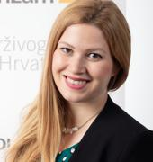
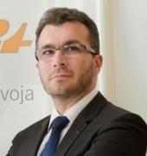
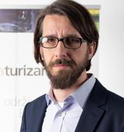
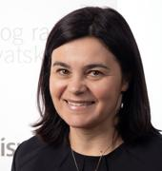
IFT NaTour4CChange Team
Dr. Izidora Marković Vukadin
Project coordinator
Izidora.markovic@iztzg.hr
Dr. Nora Mustač
Communication officer
Nora.mustac@iztzg.hr
Dr. Damir Krešić
CEO
Damir.kresic@iztzg.hr
Dr. Hrvoje Mataković
Financial manager
hrvoje.matakovic@iztzg.hr
Dr. Snježana Boranić-Živoder
expert
Snjezana.boranic@iztzg.hr

Slide 6
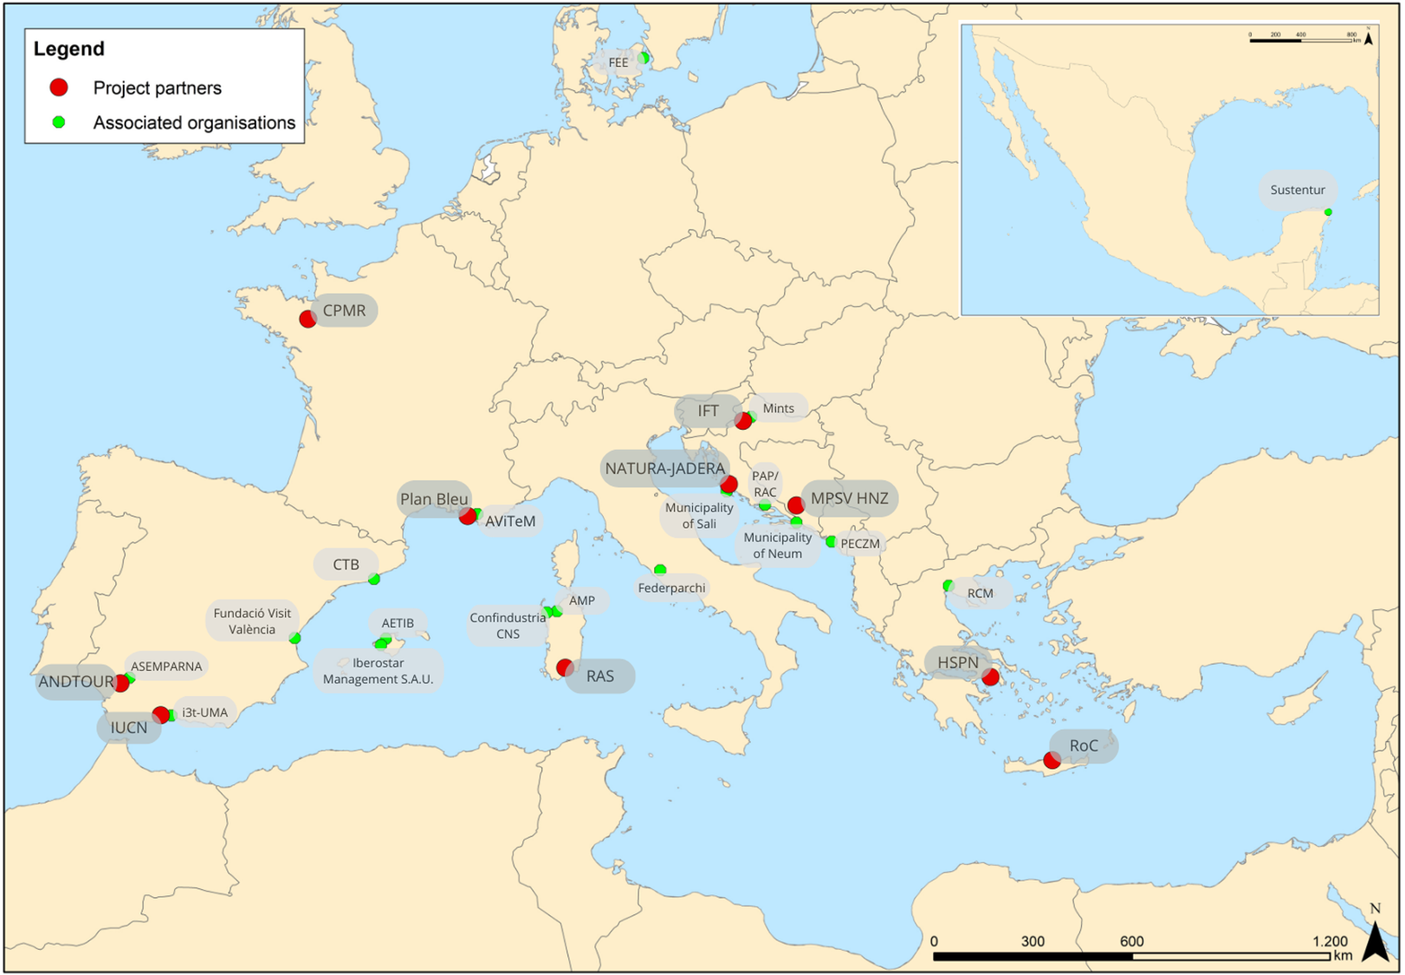
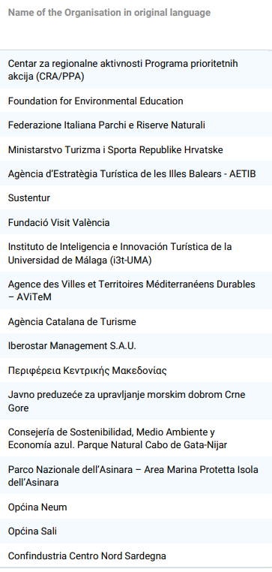
Associate partners

Slide 7
Project Background
Arnau Teixidor, IUCN Med

Slide 8
Inception of the project
Two projects on different issues around nature and tourism
Common partners: Sardinia Autonomous Region and IUCN Med
DestiMED PLUS – Tourism/Conservation Governance via Ecotourism
Partners: IFT, Andalucia Region, CPMR, Crete Region
Posbemed2 – Sustainable management of Posidonia beach-dune systems
Partners: Natura Jadera, HSPN
New partners: Pan Bleu, Herzegovina- Neretva County

Slide 9
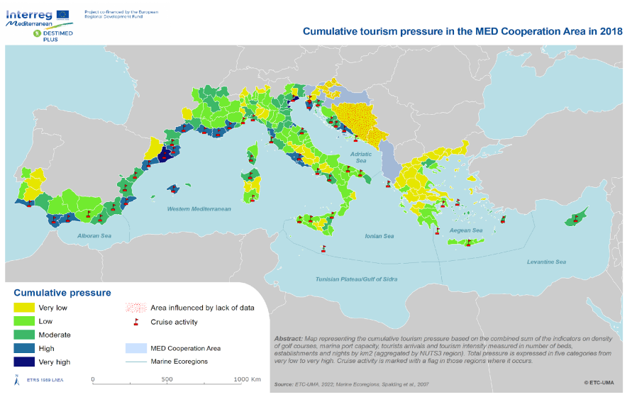
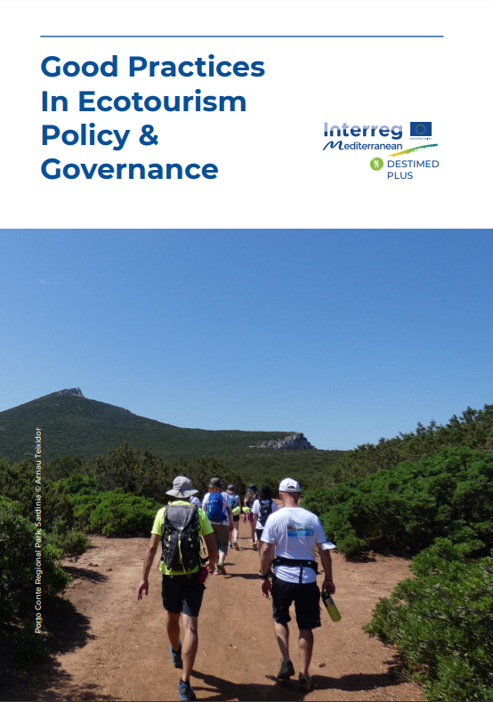
Building on DestiMED PLUS

Slide 10
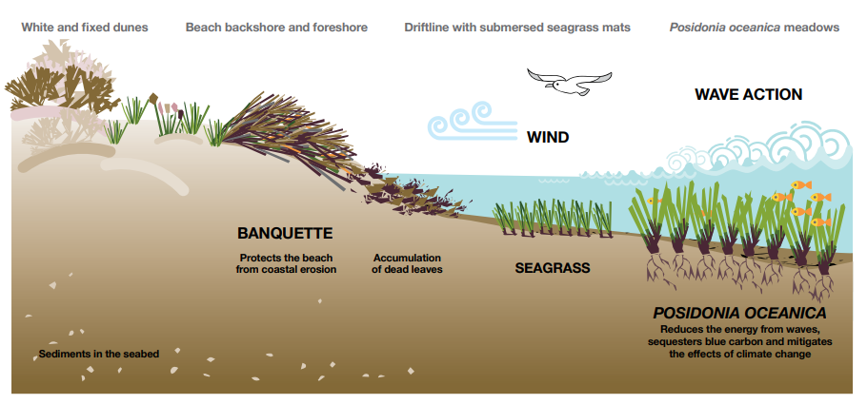
From POSBEMED2

Slide 11
Building blocks
Growing need of coastal destinations to adapt to CC
Global , regional and local need of accelerating Climate action in tourism and coastal destinations
Nature-based Solutions / societal and biodiversity benefits
Emerging role of Destination Management Organisations -
Stewardship & role of marketing and businesses to deliver change

Slide 12
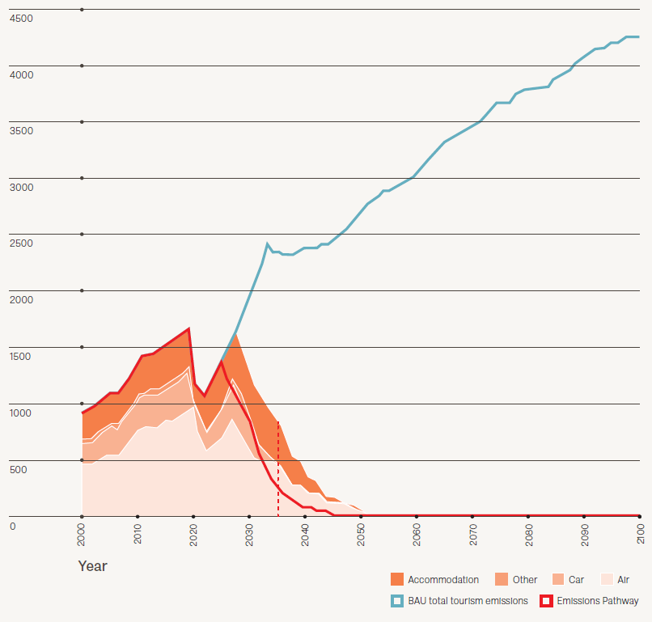
Some context
Envisioning Tourism 2050 (Travel Foundation, 2023)

Slide 13
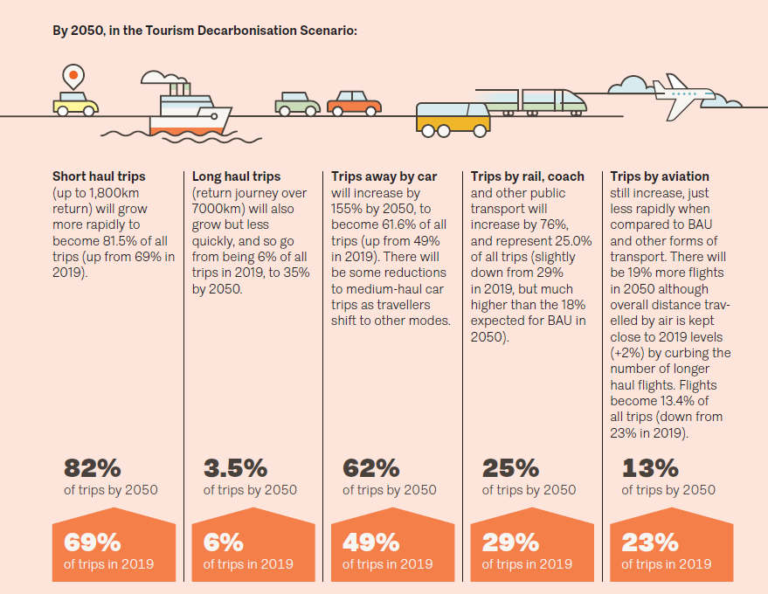

Slide 14
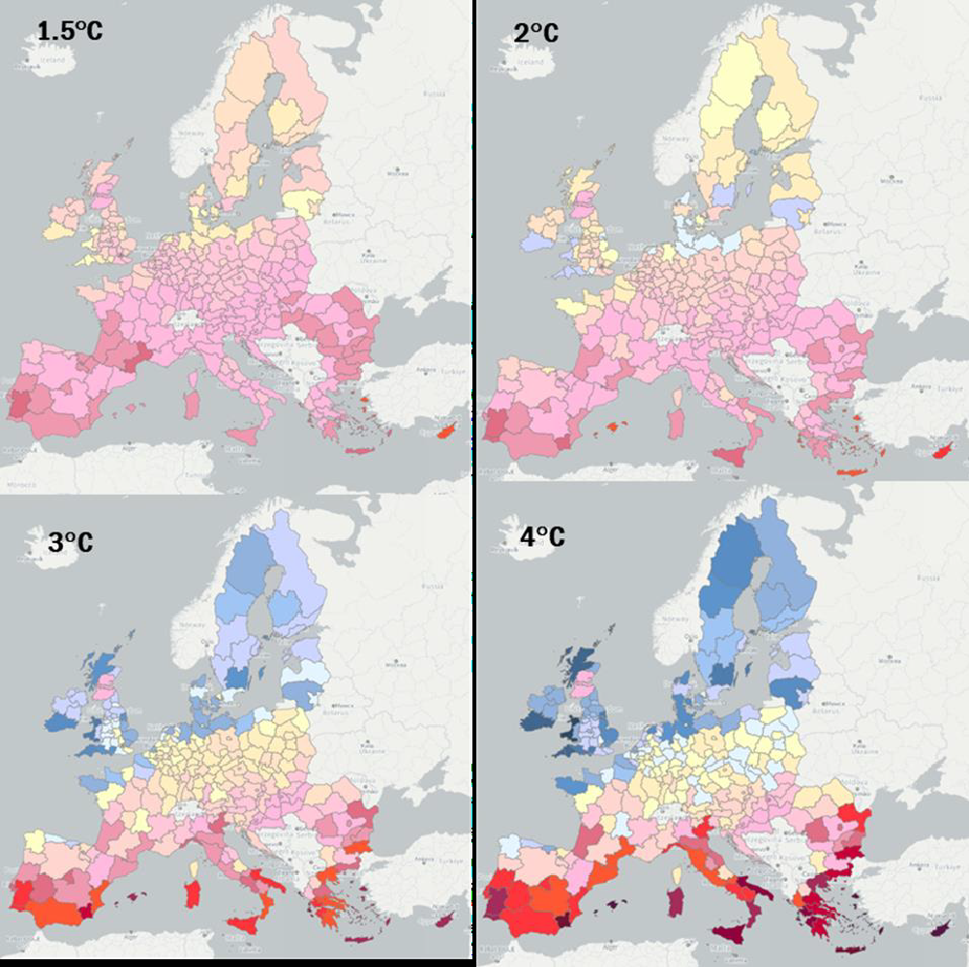
JRC, 2023

Slide 15
DECARBONISE
COLABORATE
MEASURE
REGENERATE
FINANCE

Slide 16
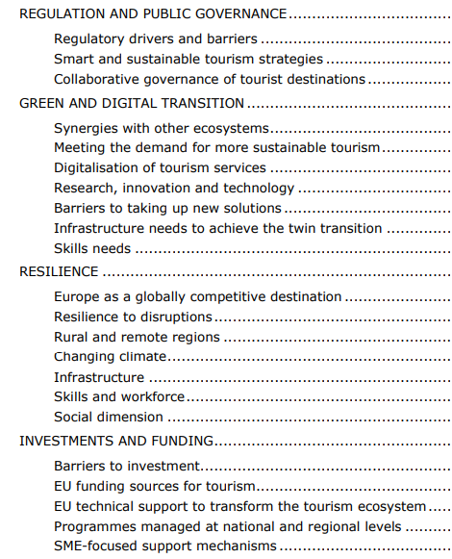
Transition Pathway for Tourism (2022)
First transition pathway co-created with industry and civil society for a resilient, green and digital tourism ecosystem

Slide 17
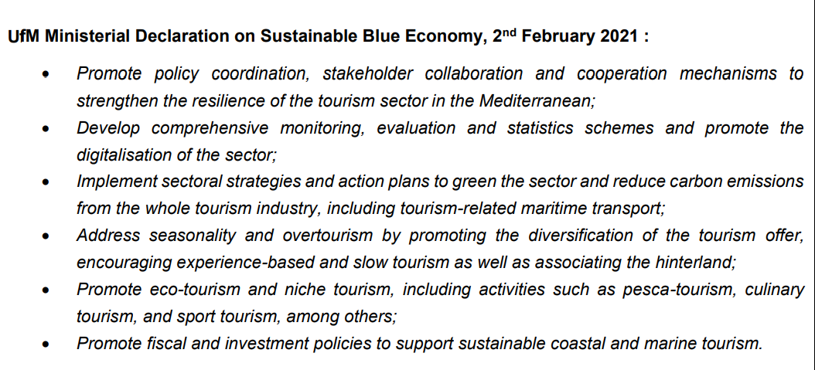
2nd UfM Ministerial Declaration on Sustainable Blue Economy (2021)
Roadmap for the implementation of the Declaration

Slide 18
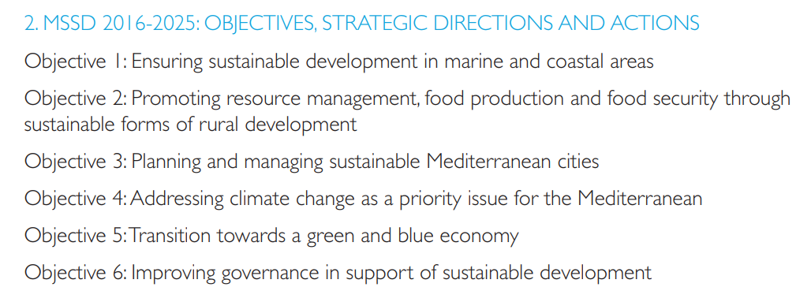
MEDITERRANEAN STRATEGY FOR
SUSTAINABLE DEVELOPMENT 2016-2025 (MSSD)

Slide 20
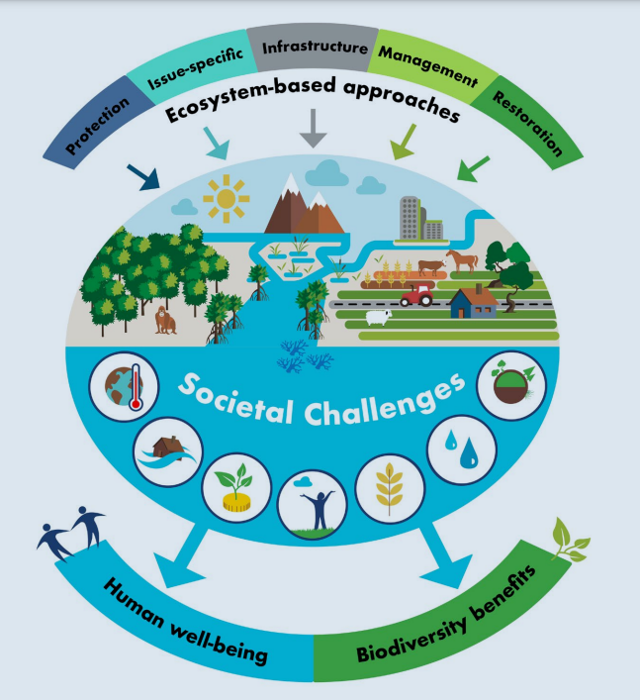
“Nature-based Solutions are actions to protect, sustainably manage and restore natural
and modified ecosystems in ways that address societal challenges effectively and adaptively, to
provide both human well-being and biodiversity benefits” (IUCN, 2016)

Slide 22
Decrease greenhouse gas emissions related to deforestation and land use
Capture and store carbon dioxide from the atmosphere
Enhance resilience of ecosystems, and as such support societies to adapt to climate hazards

Slide 23
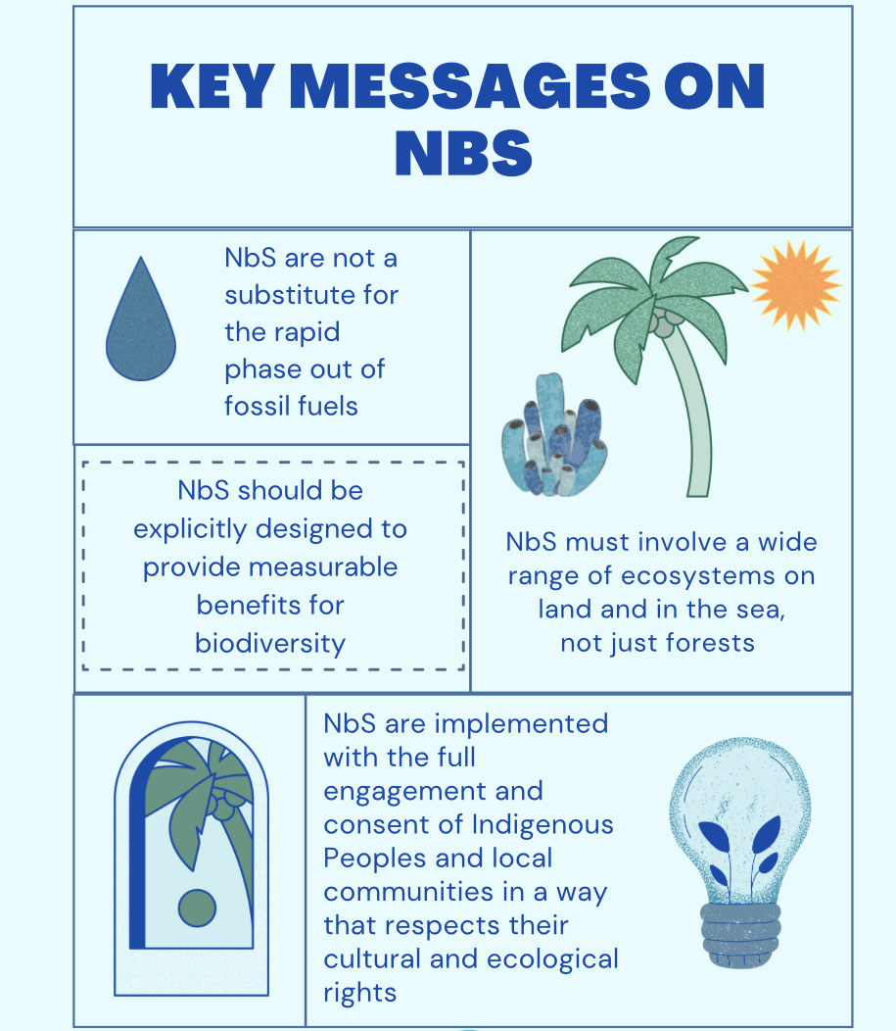

Slide 24
Project scope
Kick-off meeting
Tuesday, March 5, 2024
Luca Santarossa, consultant

Slide 25
Project’s theory-of-change
issue: tourism destinations with natural assets of high value and suffering major tourism-related impacts on/from Climate Change
=> solution: improving the regional tourism governing capacities + supporting/strengthening DMOs to test innovative solutions (i.e. Nature-based Solutions)
=> change: Regional administrations that become more effective in planning sustainable tourism in order to mitigate CC contributions and improve CC adaptation; pilot tourism destinations that become more resilient against CC impacts

Slide 26
Project’s expected outputs and results
5 Regional Strategies on Climate mitigation and adaptation for the coastal tourism sector, including Enabling conditions for delivery
6 Destination Climate Action Plans for adaptation of the coastal tourism sector
1 Capitalization Report that describes the whole approach for planning CC resilience in the tourism sector, including lessons learnt and policy recommendations
6 NbS Testing Reports

Slide 27
Project status update
Kick-off meeting
Tuesday, March 5, 2024
Izidora Marković Vukadin, project coordinator

Slide 28
Revised AF
Tehnical status
Changes:
- reducing number od deliverables (key D +internal)
- shifting periods for deliverables
- minnor changes in wording
Inputing changes in JEMS
Privilages:
- at least two per PP (editing mode)
- each partner should add LP representatives to their organization (view mode)
Adding privilages in JEMS to PP
Contracts signing
Data on ultimate beneficial owners and bank accounts

Slide 29
WP1 – activities launched 1.1.; 1.2.; 1.3., 1.4.
Activity status
WP2 - activities launched 2.1.; 2.2.; 2.3.
WP3- activities launched 3.1.; 2.3.
Communication – Basecamp, Google disk, mailing list, monthly meetings, templates

Slide 30
Financial management
Kick-off meeting
Tuesday, March 5, 2024
Hrvoje Mataković, finance officer

Slide 31
Current activities
Bank account number (on Google Drive) – required for the conclusion of the subsidy contract
Jems account - central platform for project management and reporting
Contact national authorities regarding control and certification of expenditure:
Centralised systems (Bosnia and Herzegovina, Croatia, Greece)
Decentralised systems (France, Italy, Spain)

Slide 32
Financial reporting
Three-stage process:
1) PP enter expenditure into Jems
2) National controllers check the expenditure via Jems and create a Control certificate
3) LP collects the information from each partner’s Control certificate and sends a summary of the information to JS

Slide 33
Financial reporting (2)
Period 1 (month 1 – 6) – Deadline for the entire project: 30. September 2024 (for submission of the report)
Manual, p. 70: ”As a good practice, PPs should try to provide their contribution (partner report and signed certificate and report) to the LP within one month before the deadline in order to allow LP time to synthesize the data and prepare the reporting package”.
All expenditures should be inserted in Jems - pre KoM: in a three-month interval
Suggestion: insert expenditures regularly in Jems

Slide 34
You can contact me at any time at: hrvoje.matakovic@iztzg.hr

Slide 35
Questions& disscusion

