Slide 1
Sofia, Bulgaria, 25-28 August
S74
Tools for Measuring Regional Tourism Flows (RP)
August 27th, 2026

Slide 2
Contributed Papers for This Session :
Autors | Title | Presenter
Ph.D Neven Ivandić, Institute for tourism, Croatia Ph.D Ivan Kožić, Institute for tourism, Croatia | Economic contributions of tourism: From national to regional analysis - A Case Study of Zagreb | Ph.D Neven Ivandić
Prof. Zvonimir Kuliš, University of Split, Croatia Prof. Vinko Muštra, University of Split, Croatia Prof. Blanka Šimundić University of Split, Croatia | The Developmental Limits of Tourism-Led Regional Economies | Prof. Zvonimir Kuliš
Prof. Vinko Mustra, University of Split, Croatia Prof. Zvonimir Kuliš, University of Split, Croatia | Paradise with Limits? Tourism and Development Traps on Croatian Islands | Prof. Vinko Muštra
Prof. Blanka Šimundić, University of Split, Croatia Prof Zvonimir Kuliš, University of Split, Croatia Ph.D Bogdan-Constantin Ibanescu, University of Iași, Romania Ph.D Bart Neuts, KU Leuven, Belgium | What Drives Tourism Demand Resilience in European Union Regions? A Spatial Econometric Analysis | Prof. Blanka Šimundić
The discussant for each presentation is the presenter of the next paper in the session. The first presenter is the discussant of the last paper The presentation duration is 20 minutes; I will remind you to wrap up after 18 minutes

Slide 3
Economic contributions of tourism: From national to regional analysis
- A Case Study of Zagreb, the Capital of Croatia
Sofia, Bulgaria, 25-28 August
S74 Tools for Measuring Regional Tourism Flows (RP)
August 27th, 2026
Authors: Ph.D Neven Ivandić, Ph.D Ivan Kožić

Slide 4
Motivation
Economic contributions of tourism: From national to regional analysis
Ph.D Neven Ivandić, Ph.D Ivan Kožić
The Tourism Satellite Account (TSA) is a methodologically coherent and analytically relevant framework for analyzing the characteristics of tourism activity and quantifying its direct economic contribution (Frechtling, 2010)
Despite its analytical relevance, using the TSA for tourism policy formulation faces several limitations
The TSA framework has two significant limitations:
  It lacks a focus on regional asymmetries in tourism distribution.
  It only captures direct economic flows
Providing the foundation for evidence-based national and regional tourism policy

Slide 5
Rational
THE FOUR STRATEGIC GOALS
1
TRANSPARENCY
The purpose of this paper
  To analyze the methodological framework for assessing direct and indirect regional tourism contributions, using a top-down approach applied to a selected Croatian region.
The main contribution of the paper
  An evaluation of the strengths and limitations of methodologies that downscale national data to measure regional tourism impacts.
The research hypothesis
  Despite methodological constraints, the regionalization of national data provides estimates that enhance the understanding of regional tourism economics.
A methodology harmonized with international standards (UNWTO/Eurostat).
2
COMPARABILITY
Ensuring Zagreb's data aligns with National and Regional Croatian metrics.
03
3
SCOPE
Capturing both Direct (immediate spend) and Indirect (supply chain) effects.
4
TIMEFRAME
Delivering Actuals for 2022 and robust Estimates for 2024.
Economic contributions of tourism: From national to regional analysis
Ph.D Neven Ivandić, Ph.D Ivan Kožić

Slide 6
Our Approach
A METHODOLOGICALLY RIGOROUS AND HARMONIZED FOUR-PHASE APPROACH
DATA INPUTS
Tourism satellite account for the Republic of Croatia, 2022; Croatian Bureau of Statistics,
Input-output table for Croatia, 2011; Eurostat
MODEL INTEGRATION
Calculation of the Leontief Inverse Matrix for 2021 (under the assumption of stable technical coefficients)
FORECASTING
Estimation of the Regional Tourism Satellite Account (RTSA) for the City of Zagreb for 2024, based on physical growth indices of overnight stays and inflation rates (assuming that real average visitor expenditure remains constant)
REGIONALIZATION
Compilation of the Regional Tourism satellite account for the City of Zagreb, 2022; Institute for tourism
Adaptation of national input-output table for Croatia to regional level based on location quotients
Harmonization of Table Formats
Quantification of total production generated by internal tourism consumption
Quantification of total production generated by internal tourism consumption, based on the 2021 Leontief Inverse Matrix.
Foundation:
A deterministic model based on mathematical and accounting identities within the system of national accounts
A previously tested national model that links the Tourism Satellite Account (TSA) and the input-output table
Modifications:
Adapting available national accounts data to the regional level, ensuring a methodologically coherent approach that harmonizes regional insights with national data
Forecasting based on growth indices
Economic contributions of tourism: From national to regional analysis
Ph.D Neven Ivandić, Ph.D Ivan Kožić

Slide 7
Economic contributions of tourism: From national to regional analysis
Ph.D Neven Ivandić, Ph.D Ivan Kožić
Data inputs: Croatia
European system of accounts
(ESA 2010)
Internationally compatible accounting framework for a systematic and detailed description of an economy
Tourism satellite account (TSA) for 2022
A Common Analytical Framework for Compilation
Supply and use tables (SUT) and
Input-output tables (IO) for 2021
The TSA is not a competing methodology. From a tourism-specific perspective, it provides a rigorous subset of national accounting aggregates while ensuring statistical consistency.
Issues:
Differences in the format, scope, and classification of activities and products between TSA and SUT/IO
Challenges:
Harmonization of Table Formats
Consequence:
Reduced industry/product homogeneity in the IO model

Slide 8
Economic contributions of tourism: From national to regional analysis
Ph.D Neven Ivandić, Ph.D Ivan Kožić
Regionalisation
Regional Tourism satellite account (TSA) for Zagreb
National IO tables adapted for regional analysis
Bottom-up regional compilation is not feasible due to the absence of specific regional supply and use tables
Therefore, the national TSA was regionalized based on regional tourism activity indicators (employment, accommodation capacity, physical tourism volume, and the Gross Value Added (GVA) of key industries)
Regionalization results are derived from the Institute for Tourism’s project 'Establishing the System of Satellite Accounts for Sustainable Tourism of the Republic of Croatia', funded by the European Union under the NextGenerationEU programme
Technical coefficients in Zagreb's RTSA-formatted IO table are adjusted using location quotients to reflect regional-national economic structural differences
Location quotients were calculated based on the ratio between the gross value added of individual activities and total gross value added at both the regional and national levels
Challenges:
Relevance of regionalization indicators due to a high share of non-tourism services in tourism industries' output
Size and scope of the residual sector, which is significantly larger in Zagreb than in other Croatian regions which is vital for ensuring sector homogeneity, a key assumption of input-output analysis
Location quotients are an approximation of inter-regional trade
Consequence:
Reduced industry/product homogeneity and its potential impact on the calculation of direct and indirect contribution of tourism and non-tourism activities

Slide 9
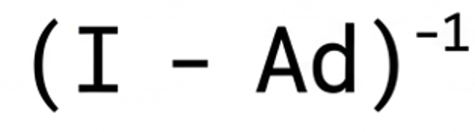

Economic contributions of tourism: From national to regional analysis
Ph.D Neven Ivandić, Ph.D Ivan Kožić
Model integration and forecasting
Model integration
Forecasting
Calculation of the Leontief Inverse Matrix for 2021 under the assumption of stable technical coefficients from Zagreb's RTSA-formatted IO table:
Elements of the Leontief Inverse Matrix represents the total (direct and indirect) output required from sector (i) to satisfy a one-unit increase in the final demand of sector (j)
Total production generated by internal tourism consumption is quantified by multiplying the Leontief inverse matrix and the column vector of internal tourism consumption obtained from Zagreb's RTSA
Compilation of the Regional Tourism Satellite Account (RTSA) for the City of Zagreb for 2024
The compilation is based on available data, where 2022 data are indexed using a combination of the growth in physical tourism activity from 2022 to 2024 and price growth of corresponding products over the same period (e.g., price growth in accommodation, food and beverage services in restaurants, transport, and general price growth for other products
Total production generated by internal tourism consumption in 2024 is quantified by multiplying the Leontief inverse matrix for 2021 by the column vector of internal tourism consumption obtained from Zagreb's RTSA for 2024
Challenges:
Issues regarding sector homogeneity resulting from the alignment of different data inputs and the regionalization process
Lack of data on tourism expenditure for 2024.
Consequence:
Potential impact on the calculation of direct and indirect contributions of tourism and non-tourism activities

Slide 10
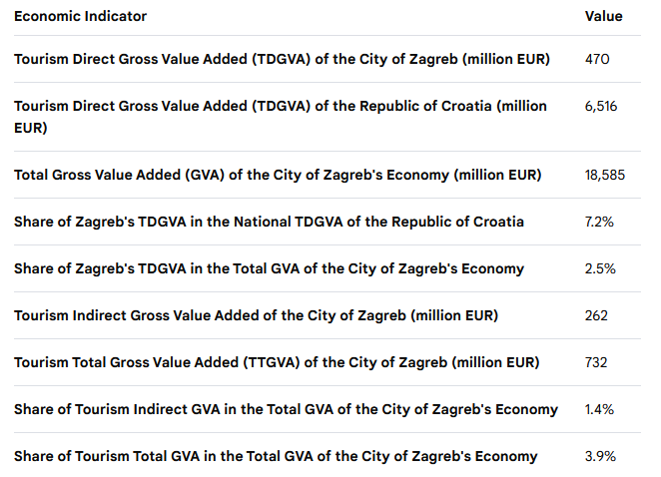
Economic contributions of tourism: From national to regional analysis
Ph.D Neven Ivandić, Ph.D Ivan Kožić
Model results (if anyone is interested)
Tourism Macro-aggregates in the City of Zagreb and the Republic of Croatia in 2022

Slide 11
Economic contributions of tourism: From national to regional analysis
Ph.D Neven Ivandić, Ph.D Ivan Kožić
Conclusions:
Objectives Achieved
Study Limitations
Research Outcomes
Developed regional framework based on an internationally harmonized approach for systematic and detailed assessment of tourism's direct and indirect economic impacts
Data limitations, particularly regarding regional supply and use tables
A high level of aggregation, reflecting the standard definition of tourism products and industries
A roadmap for improving statistical data collection frameworks, particularly in tourism-driven economies and regions
A foundation for enhancing policymaking capacity to improve tourism management efficiency and mitigate tourism pressures

